Slide 1

NAME: DIKSHANT KUMAR SINGH
AUTOMATED SORTING SYSTEM USING MECHATRONICS PRICIPLE
.
IINTEL UNNATI INDUSTRIAL TRAINING

Slide 2

Automated Sorting System: A Mechatronics Approach Automated sorting systems are essential for modern industries. They enhance efficiency, reduce errors, and improve productivity.
Dikshant kumar Singh

Slide 3

Introduction: The Need for Automated Sorting
Automated sorting systems are crucial in manufacturing, logistics, and recycling. They offer benefits like improved efficiency, accuracy, and speed. Moreover, they reduce costs. The focus is on mechatronics principles and seamless system integration.

Slide 4

System Design: Mechatronics Components
Mechanical design: Conveyor belt, sorting mechanism (e.g., pneumatic cylinders, robotic arm). Electrical components: Sensors, actuators (motors, solenoids), power supply.
Computational components: Microcontroller, control algorithm, user interface. The system architecture diagram provides a visual overview.

Slide 5
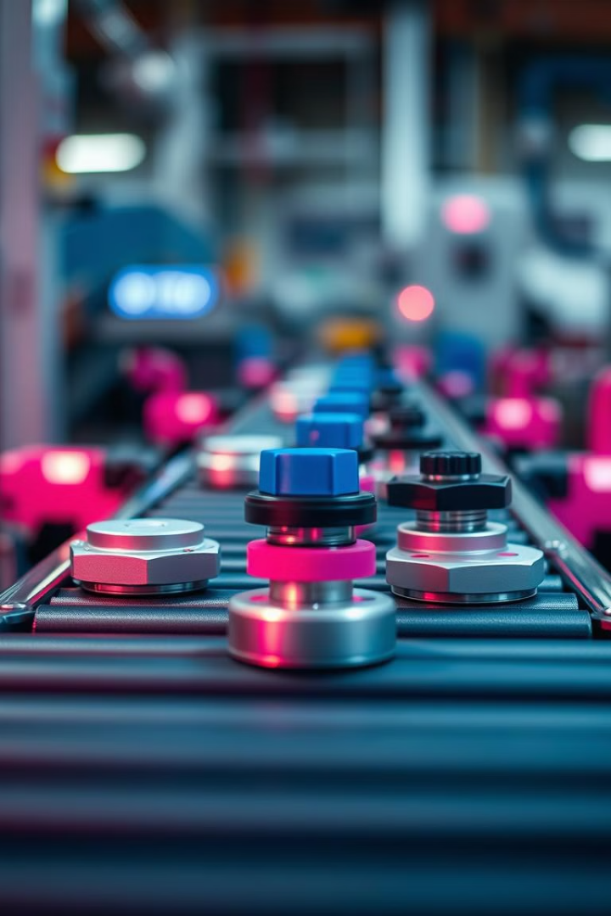
Sensor Integration and Data Acquisition
Proximity, color, and weight sensors are essential. Sensor data is processed and analyzed. Algorithms identify and categorize objects. Calibration ensures accuracy. These details are crucial for effective performance.

Slide 6
Control System Implementation
Microcontrollers (Arduino, Python) are programmed. Control algorithms manage actuators. Feedback mechanisms correct errors. Real-time performance ensures responsiveness. This is essential for efficiency.

Slide 7
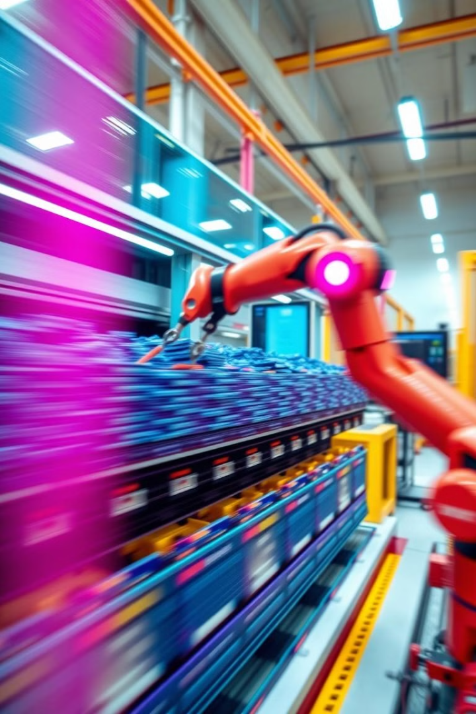
Implementation and Testing
The system undergoes assembly and wiring. Functional, performance, and reliability tests are conducted. Sorting speed, accuracy, and throughput are measured. Troubleshooting and optimization are key for refinement.

Slide 8
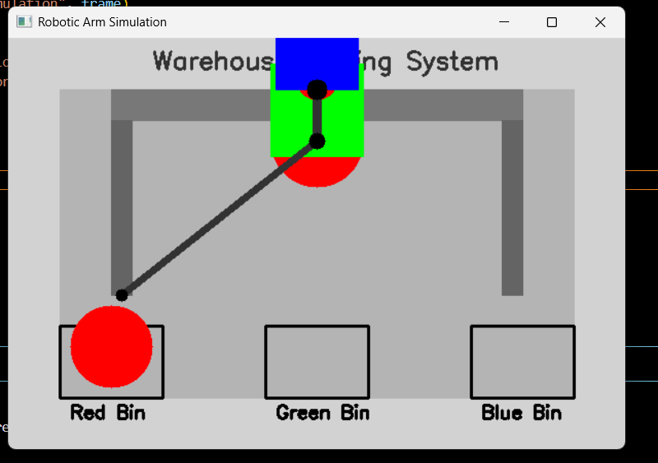
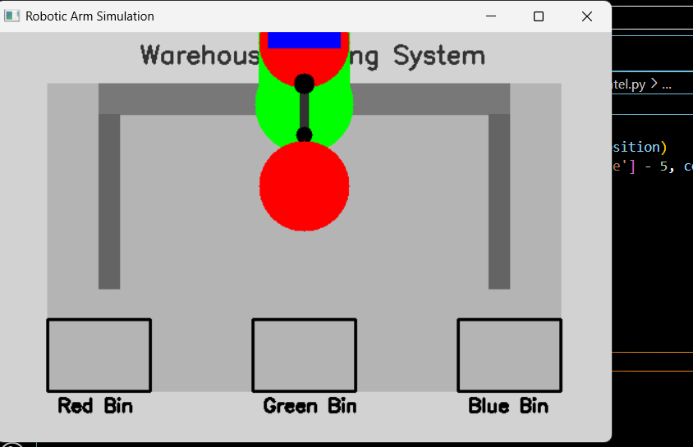

Slide 9

Results and Discussion
Quantitative results show sorting speed, accuracy, and throughput.
The system is compared with manual sorting methods. Advantages and limitations are analyzed. Future improvements and scalability are also considered.

Slide 10

Conclusion and Future Work
The automated sorting system was designed and implemented. Key takeaways emphasize mechatronics integration. Future research includes advanced sensors and improved algorithms. Expanding the system to handle diverse objects is planned.
VIDEO LINK: https://youtu.be/NB4fNkeCd9E

